Slide 1
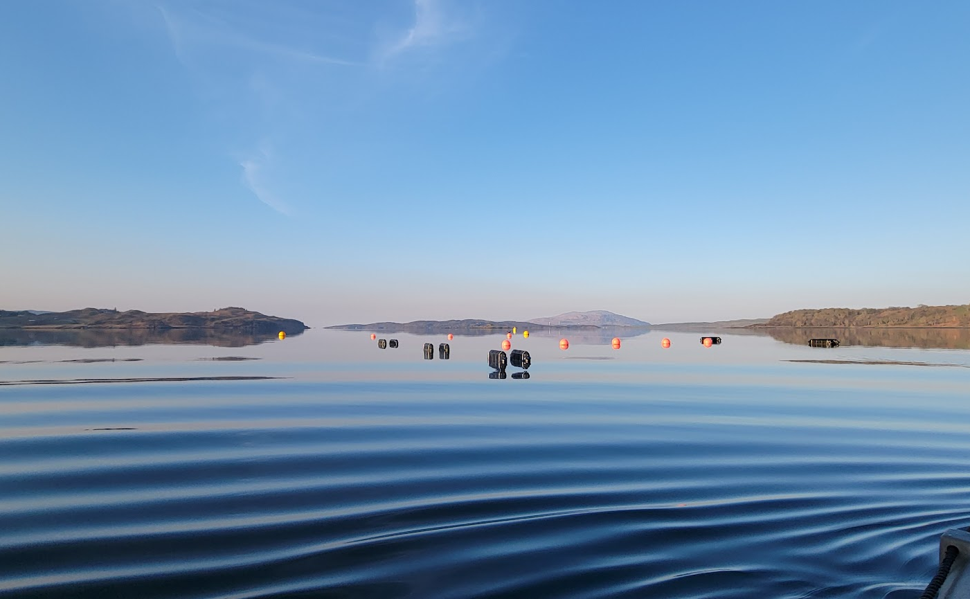

Investigating biofouling in seaweed aquaculture using eDNA diagnostics
Calum Young
1st year PhD student
University of Glasgow, Scotland

Slide 2
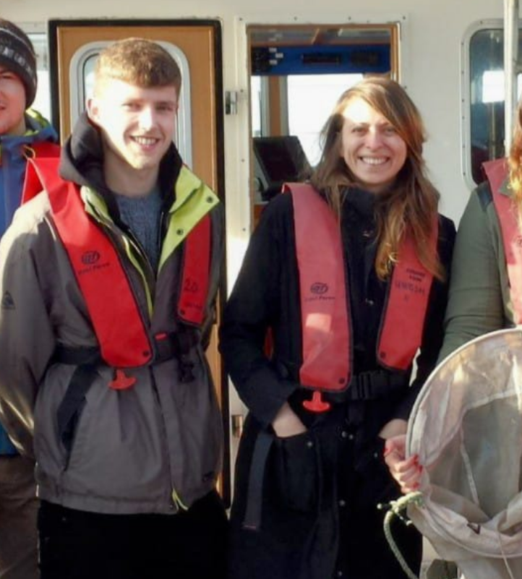




Calum Young
BSc (Hons) Freshwater and Marine Biology – UoG
MSc Marine Biology – Stockholm University
PhD Marine Ecology – UoG (Started November 2024)
ca. 2016
2013 - 2017
2018 - 2021
2024 -
Notes:
So just to give you a little introduction, I started my studies at Glasgow university where I completed a undergrad in Freshwater and marine biology.
I then went onto Stockholm University where I completed a masters in marine biology, where first got involved using eDNA during my thesis looking at phytoplankton seasonality in galapagos mangroves.
In November last year, I returned to Glasgow university after a few side quests growing oysters and rescuing sea turtles where I am now a first year phd student the project of which I am going to introduce to you

Slide 3
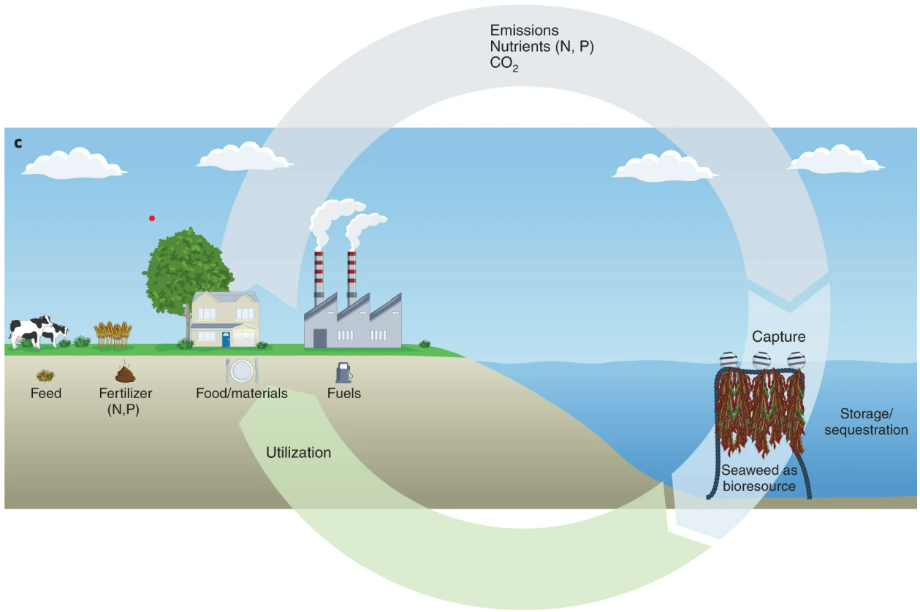
Seaweed-Based Circular Bioeconomy
Duarte et al. (2022)
Notes:
seaweed mariculture has grown into a billion-dollar industry and now accounts for 51.3% of global mariculture production and is growing
Today global seaweed cultivation is a hot topic due to its broad range of potential ecosystem services such as supporting food security and providing high-value bioproducts for industries like medicine, textiles and agriculture as potential biofuels.
The use of seaweed biomass enables reuse of carbon and nutrients from land operations and can replace products that have a higher CO₂ footprint
Seaweed farming offers a low-impact alternative to finfish aquaculture and can play a role in integrated multitrophic aquaculture (IMTA) while supporting more diverse sustainable economy particularly to remote coastal communities

Slide 4
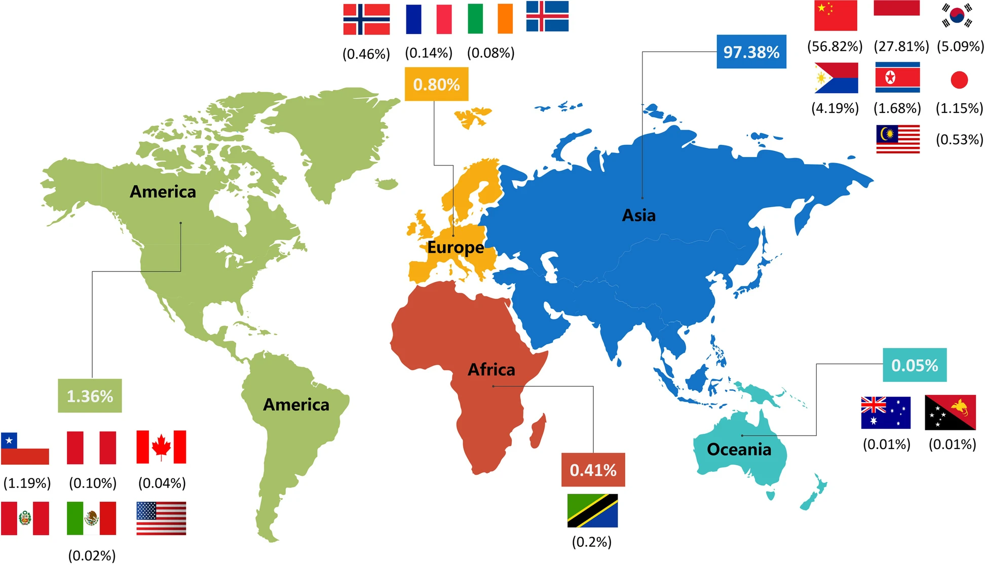
Seaweed production in the year 2019 - Zhang et al. (2022)
Notes:
Currently 97% of seaweed production is within Asia markets, predominantly china as you can see from FAO data from 2019
Other regions such as the northeast Atlantic are showing gradual expansion but there exists a critical bottleneck in commercial profitability for
European farms which is the inherent difficulties in scaling up operations.

Slide 5
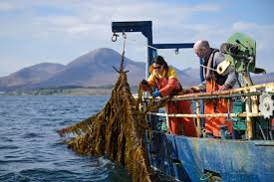
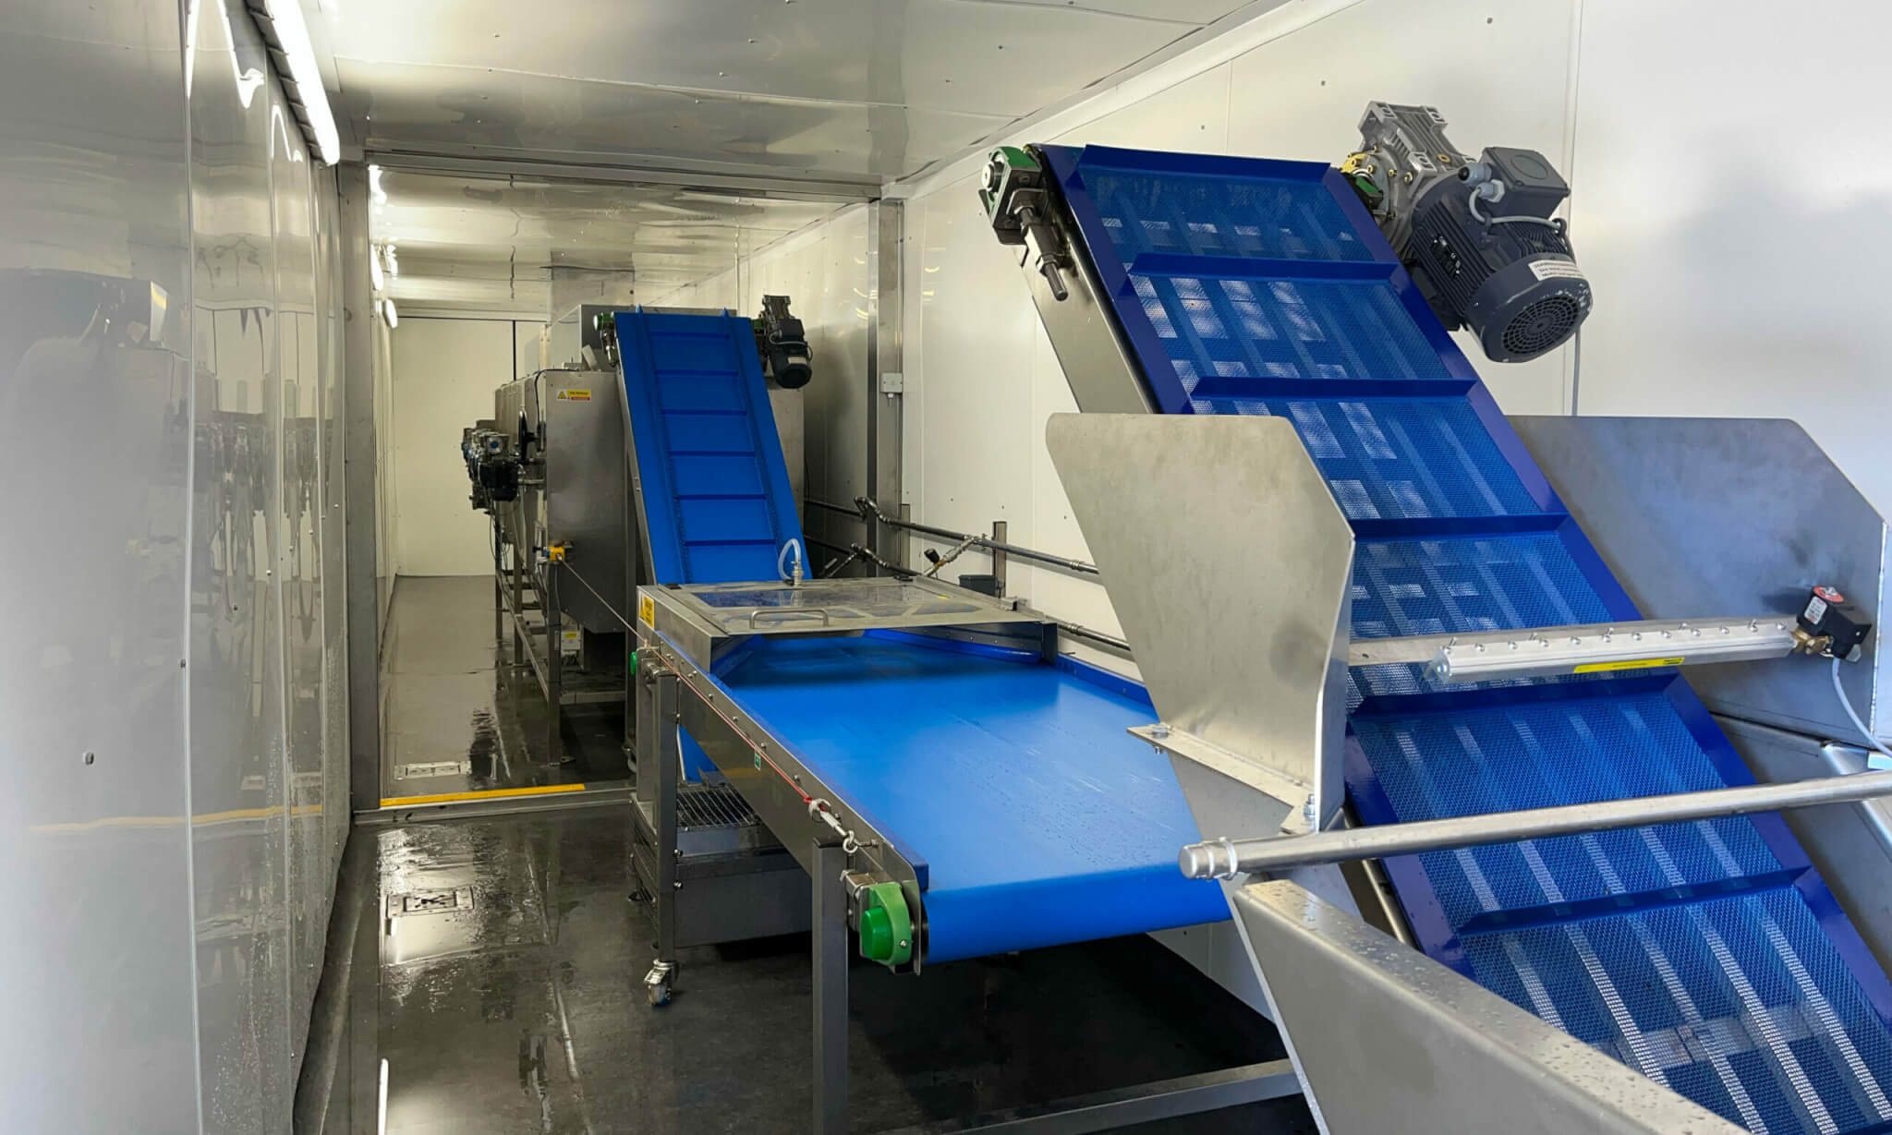
Seaweed Processing Plant | Eco Cascade CIC | GlenFarrow)
Notes:
Key barriers to expansion within the European algae sector include high production costs, limited market awareness and inconsistent production qualities.
There are severe limitations in storage, processing and supply chains .
For example, in Scotland there is now only one commercial facility for processing seaweed up near isle of skye which greatly restricts cultivators' maintenance a viable product considering seaweed has to be preserved either by drying or wet processing within roughly 48 hours of being removed from the sea.

Slide 6
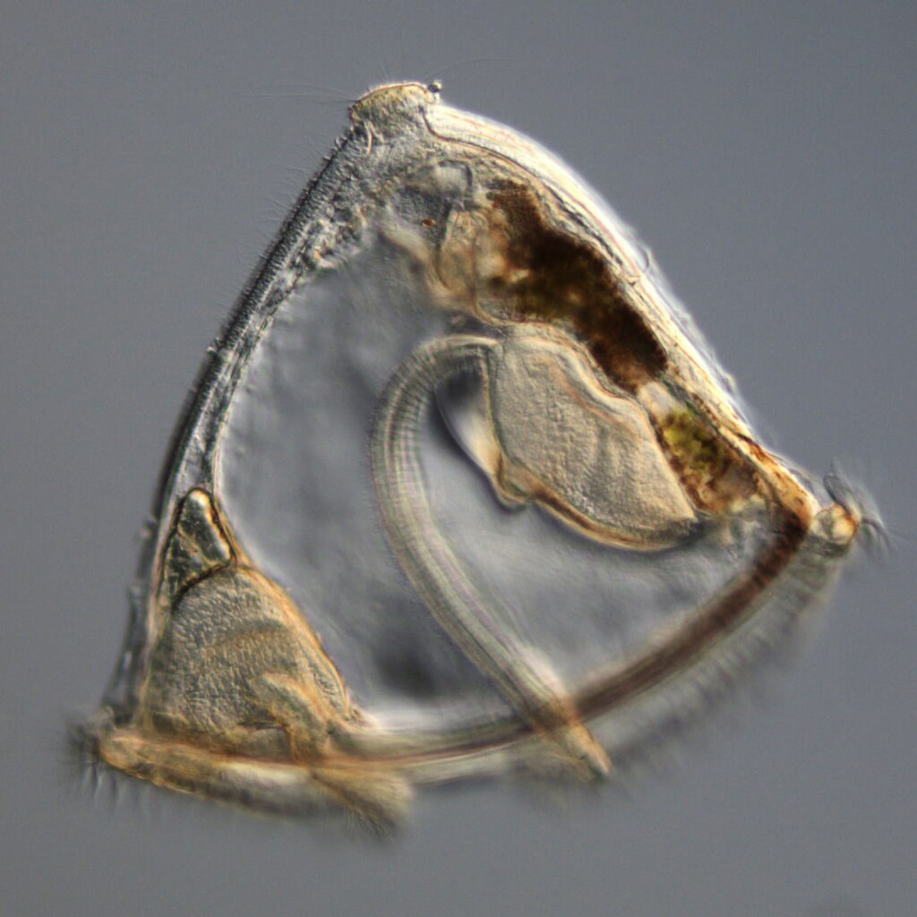
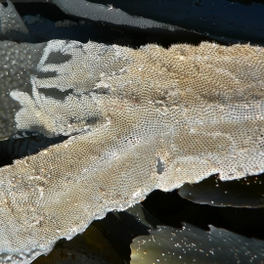
Seaweed Epibionts / Biofouling Species
Bryozoan cyphonaute
(plankton)
Bryozoan mat : M. membranacea (biofouling)
Notes:
In addition to the current logistical constraints on land, there also exists problematic factors within the sea itself
The same lovely cold nutrient rich coastline conditions that make the northeast Atlantic so suitable for commercial seaweed production are also highly favoured by biofouling organisms which are harmful to the algae
These epibionts which are organisms that live on the surface of another, greatly impact the yield of seaweed crops hindering the expansion of seaweed farming in the region.
Meroplanktonic forms of bryozoans, hydrozoans, bivalves, tunicates, crustaceans drift in on currents seeking out a suitable landing platform to settle.

Slide 7
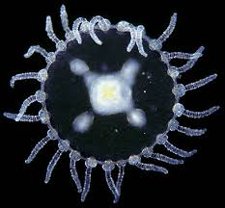
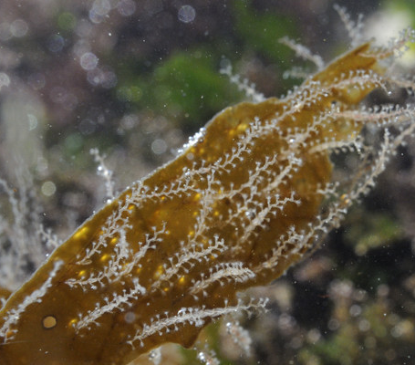
Seaweed Epibionts / Biofouling Species
Hydrozoan Obelia sp. Medusa
(plankton)
Hydrozoan Obelia dichotoma
(biofouling)
Notes:
Once established on the frond - species and can quickly proliferate and cover much if not off the seaweed blade with a matter of months depending on the species and conditions.
https://www.ispotnature.org/communities/uk-and-ireland/view/observation/136907/hydroid-colonies-attached-to-kelp-frond-

Slide 8
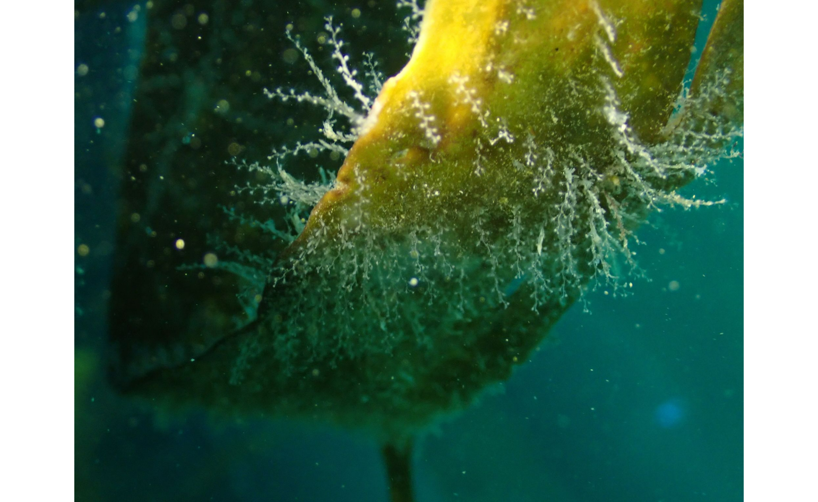
Impacts to seaweed
Hydrozoan Obelia geniculata
Notes:
Biofouling settlement on both wild and cultivated seaweed has a variety of impacts

Slide 9
Impacts to seaweed
Physical damage : Increased weight and drag = breakage (whipping) / dislodgment
Hydrozoan Obelia geniculata
Notes:
Foremost is the physical damage to the frond by reducing their flexibility, increasing their weight and drag, and this then leads to more breakages and dislodgement, especially so during high-wave energy events.

Slide 10
Impacts to seaweed
Physical damage : Increased weight and drag = breakage (whipping) / dislodgment
Growth inhibition : Competition for light, nutrients, spore release, tissue necrosis
Hydrozoan Obelia geniculata
Notes:
They can disrupt physiological processes by impairing photosynthesis and nutrient exchange, this can block reproductive spore release and can ultimately lead to tissue necrosis.

Slide 11
Impacts to seaweed
Physical damage : Increased weight and drag = breakage (whipping) / dislodgment
Growth inhibition : Competition for light, nutrients, spore release, tissue necrosis
Economic losses : Reduced yield / quality / taste, increased allergen risks / increased processing time and labour costs
Hydrozoan Obelia geniculata
Notes:
And critically to farmers is the commercial value of seaweed decreasing as fouling worsens due to more waste, deterioration of frond quality and taste, and a heightened allergen risk to humans – a major one being shellfish allergies if for example mussels are found on the blades

Slide 12
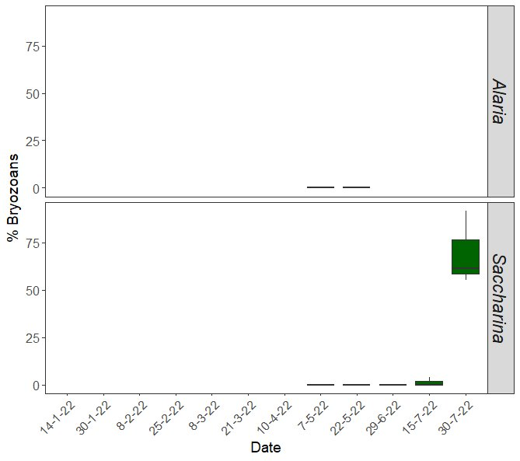
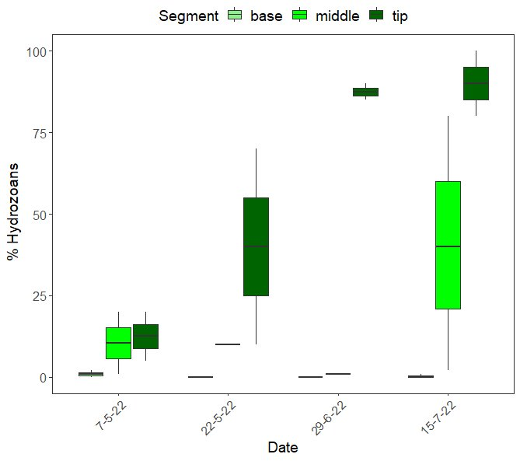
Biofouling rapidly increases in spring / summer
Bryozoan Coverage
Hydrozoan Coverage
Sofie Spatharis, KelpCrofting Pilot Study 2022
Notes:
Biofouling on seaweed farms is highly seasonal, typically peaking between spring and summer. The timing and dominant species vary depending on year, location, latitude, and depth.
These two plots show biofouling coverage over time. The x-axis represents time, and the y-axis shows the percentage of seaweed blades covered.
Both bryozoans and hydrozoans show a sharp rise in coverage seen by late July—just two months after initial detections in May.
Because of the rapid spread and impact on crops, farmers often harvest before biofouling organisms appear, shortening the growing season.
Given that kelp can grow up to 5 cm per day, even a small reduction in the season can significantly impact yield.
That’s why it's crucial to pinpoint when biofouling organisms are most active and what conditions drive their settlement.

Slide 13
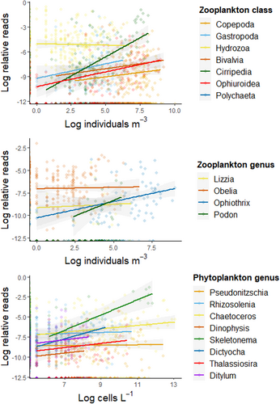
Knowledge gap - Challenge
We need fast and accurate early warning systems of the planktonic stages of bryozoan and hydrozoan epibionts!
eDNA shows promise BUT still a way to go…
Previous investigations between plankton microscope counts and eDNA metabarcoding of whole plankton community showed weak correlations
Imperative to design species or clade specific primer and use a quantitative approach for eDNA monitoring
Algueró-Muñiz et al. 2024. High-Resolution Longitudinal eDNA metabarcoding and morphological tracking of planktonic threats to salmon aquaculture. Environmental DNA
Notes:
To manage biofouling effectively, we need fast, accurate early warning systems for detecting the planktonic stages of bryozoan and hydrozoan epibionts.
Environmental DNA, or eDNA, shows potential—but it’s just quite not there yet.
Studies comparing traditional plankton counts with eDNA metabarcoding have shown weak correlations, highlighting the need for refinement.
To improve accuracy, it's crucial to develop species- or clade-specific primers and adopt a quantitative approach to eDNA monitoring.

Slide 14
PhD Aim and objectives
AIMS:
Optimise the use of eDNA as an early warning system of biofouling in seaweed aquaculture
Notes:
The overall aim of this project is to optimise the use of eDNA as an early warning system of biofouling in seaweed aquaculture

Slide 15
PhD Aim and objectives
AIMS:
Optimise the use of eDNA as an early warning system of biofouling in seaweed aquaculture
OBJECTIVES:
Detect key biofouling epibionts (e.g., hydrozoans, bryozoans) using species-specific primers from high-copy genomic regions.
Predict biofouling events by correlating eDNA data with microscopy counts; validate predictive accuracy across taxa.
Identify critical environmental drivers (e.g., temperature, salinity, PAR, nutrients, current) influencing seasonal biofouling dynamics.
Inform sustainable farming by integrating molecular and environmental data to guide harvest timing and antifouling strategies.
Notes:
OBJECTIVES:
Detect key biofouling epibionts (e.g., hydrozoans, bryozoans) using species-specific primers from high-copy genomic regions.
Predict biofouling events by correlating eDNA data with microscopy counts; validate predictive accuracy across taxa.
Identify critical environmental drivers (e.g., temperature, salinity, PAR, nutrients, current) influencing seasonal biofouling dynamics.
Inform sustainable farming by integrating molecular and environmental data to guide harvest timing and antifouling strategies.

Slide 16



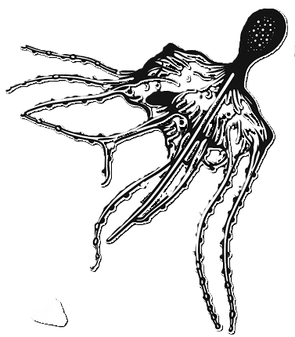



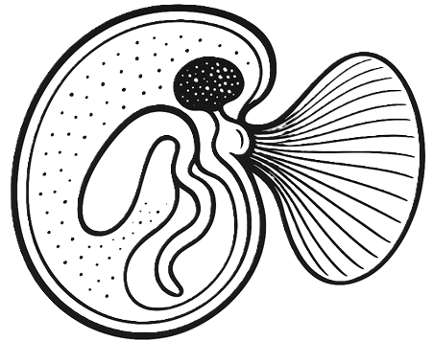

Precursor. Isle of Skye – Kelpcrofters Seaweed Farm
Jun 21
Sep 21
Nov 21
Jan 21
Mar 22
April 22
May 22
Jun 22
July 22
Plankton ID via microscopy
Plankton ID via eDNA
Blade epibionts – blade area coverage
Outcomes
Objective 1
Objective 2
Objective 3
Evaluate molecular vs. microscopy methods for identifying epibionts on blades and in plankton
Assess time lags between planktonic presence and blade settlement of epibionts
Test depth effects on epibiont distribution on seaweed blades
Notes:
As a precursor to my the project I have started working on a given dataset that sampled plankton, edna and seaweed fronds from which I intend to
Evaluate molecular vs. microscopy methods for identifying epibionts on blades and in plankton
Assess time lags between planktonic presence and blade settlement of epibionts
Test depth effects on epibiont distribution on seaweed blades

Slide 17
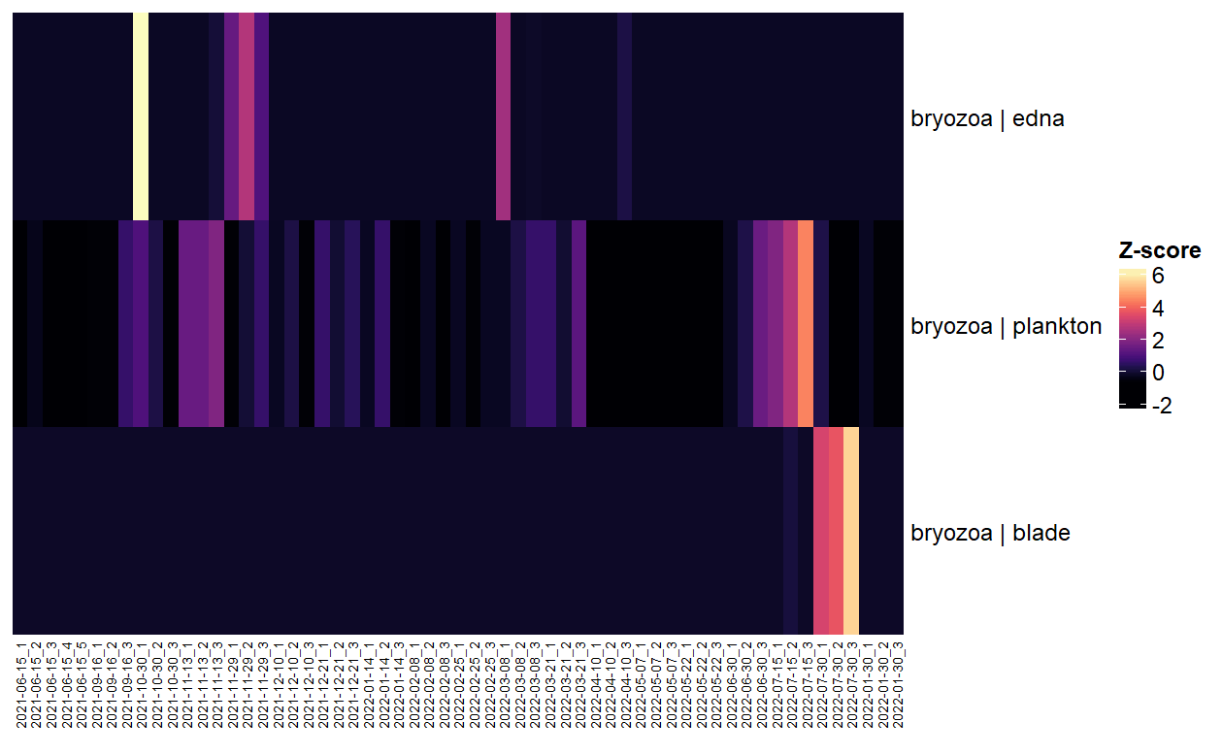
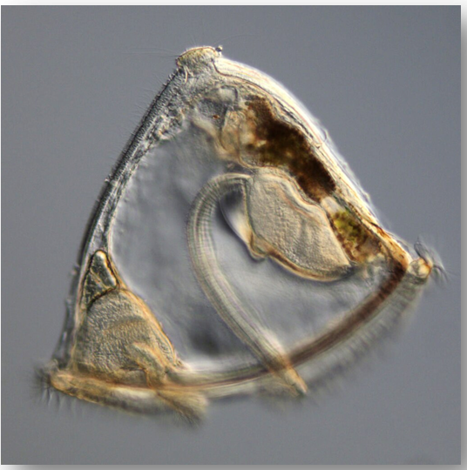
Assess time lags between planktonic presence and blade settlement of epibionts
Notes:
The heat map shows normalised data from the three measurement types with date along the bottom – sorry not very clear – June 2021 on far left and January 2022 on far right
Although the metabarcoding is detecting bryozoan eDNA – which is great – there is clear mismatch with the visual data –
Metabarcoding is limited by the lack of a universal marker across phyla, this results in detection inconsistencies from amplification biases caused by selectivity of the used primer
This reaffirms species- or clade-specific primers and adopt a quantitative approach when using eDNA in biomonitoring

Slide 18
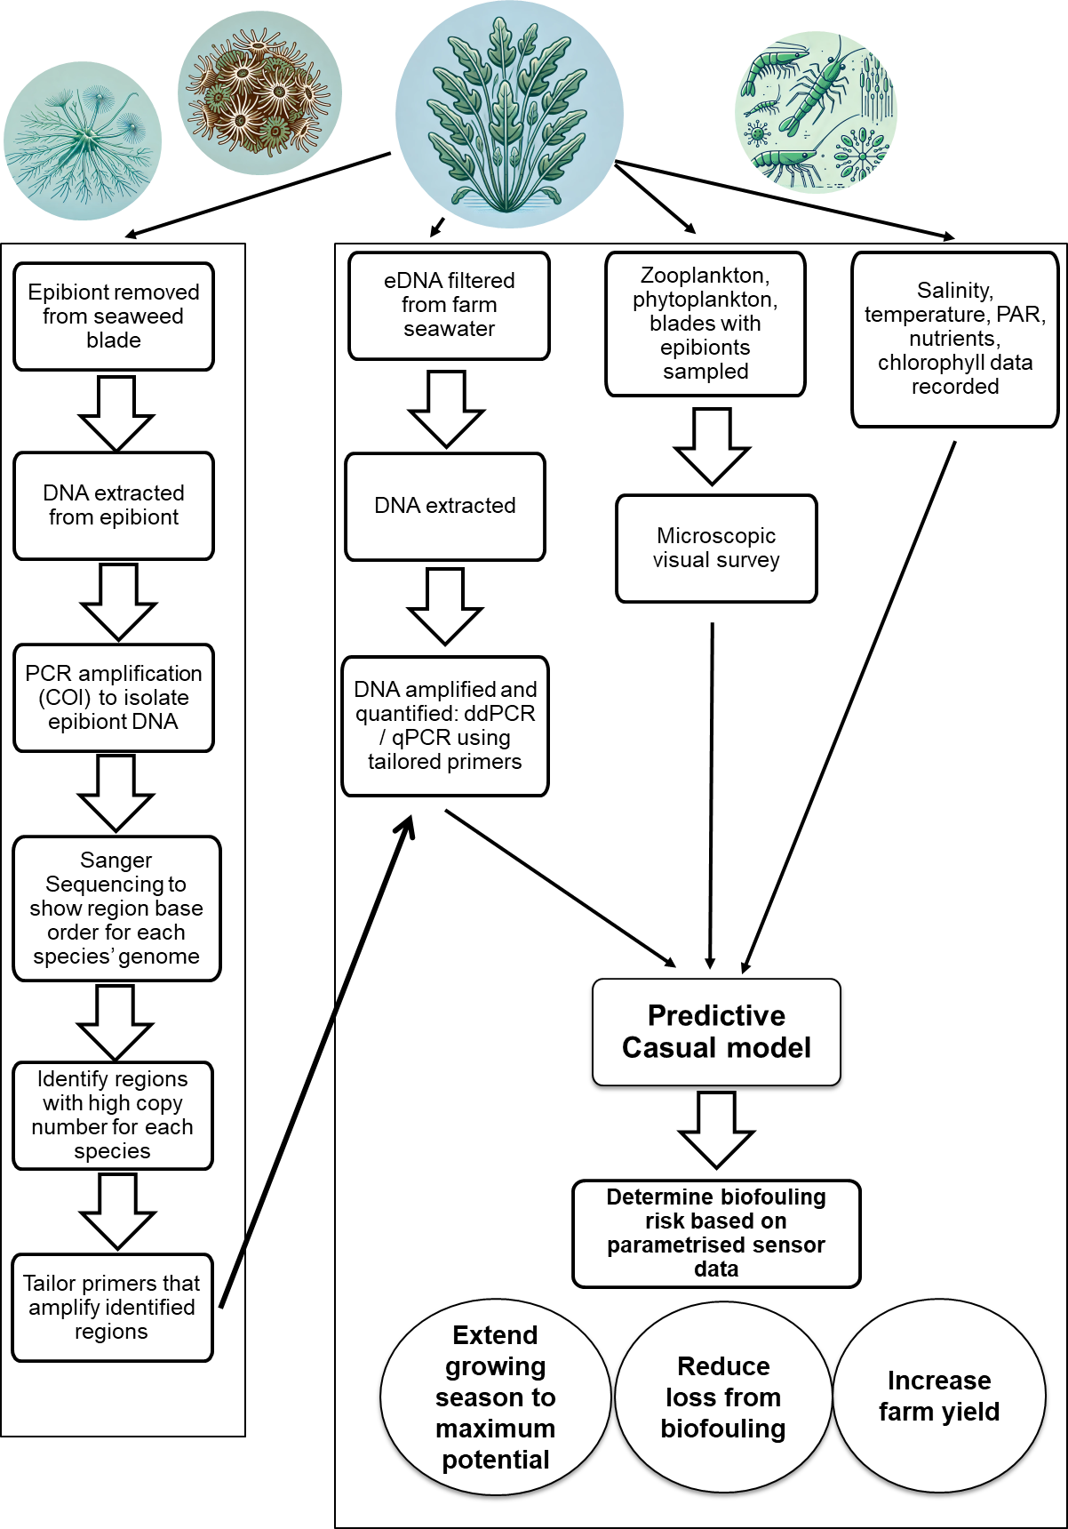
Notes:
This is a basic overview of what I intend to do

Slide 19
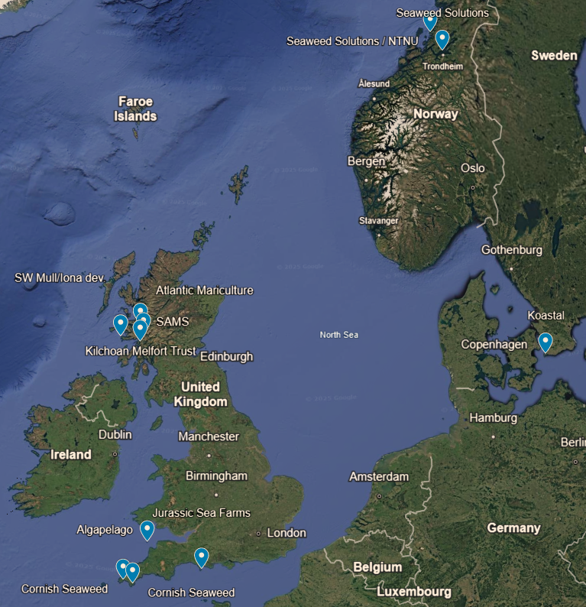
Sampling Farm Locations (n = 11)
Norway:
Seaweed Solutions / NTNU x 2
Sweden:
- Koastal
Scotland:
Kilchoan Crown Estate
Atlantic Mariculture
Scottish Assosciation of Marine Science (SAMS)
Southwest Mull and Iona Development
England:
Algapelago
Jurassic Sea Farms
Cornish Seaweed x 2
Sampling frequency:
Nov – Feb: monthly
March – August: bimonthly
Notes:
In total, we are sampling 11 seaweed farms located in Norway, Sweden, Scotland, and England. These sites represent a wide range of environmental variables, including differences in temperature, salinity, nutrient availability, and hydrodynamic conditions.
This broad spatial coverage will help us understand how regional differences influence biofouling risks and meroplankton dynamics
Sampling began in November and follows a structured timeline to capture seasonal dynamics. From November to March, monthly sampling establishes a baseline during lower biofouling activity.
From March onward, bi-monthly sampling provides higher-resolution data as biofouling organisms become more prevalent.

Slide 20
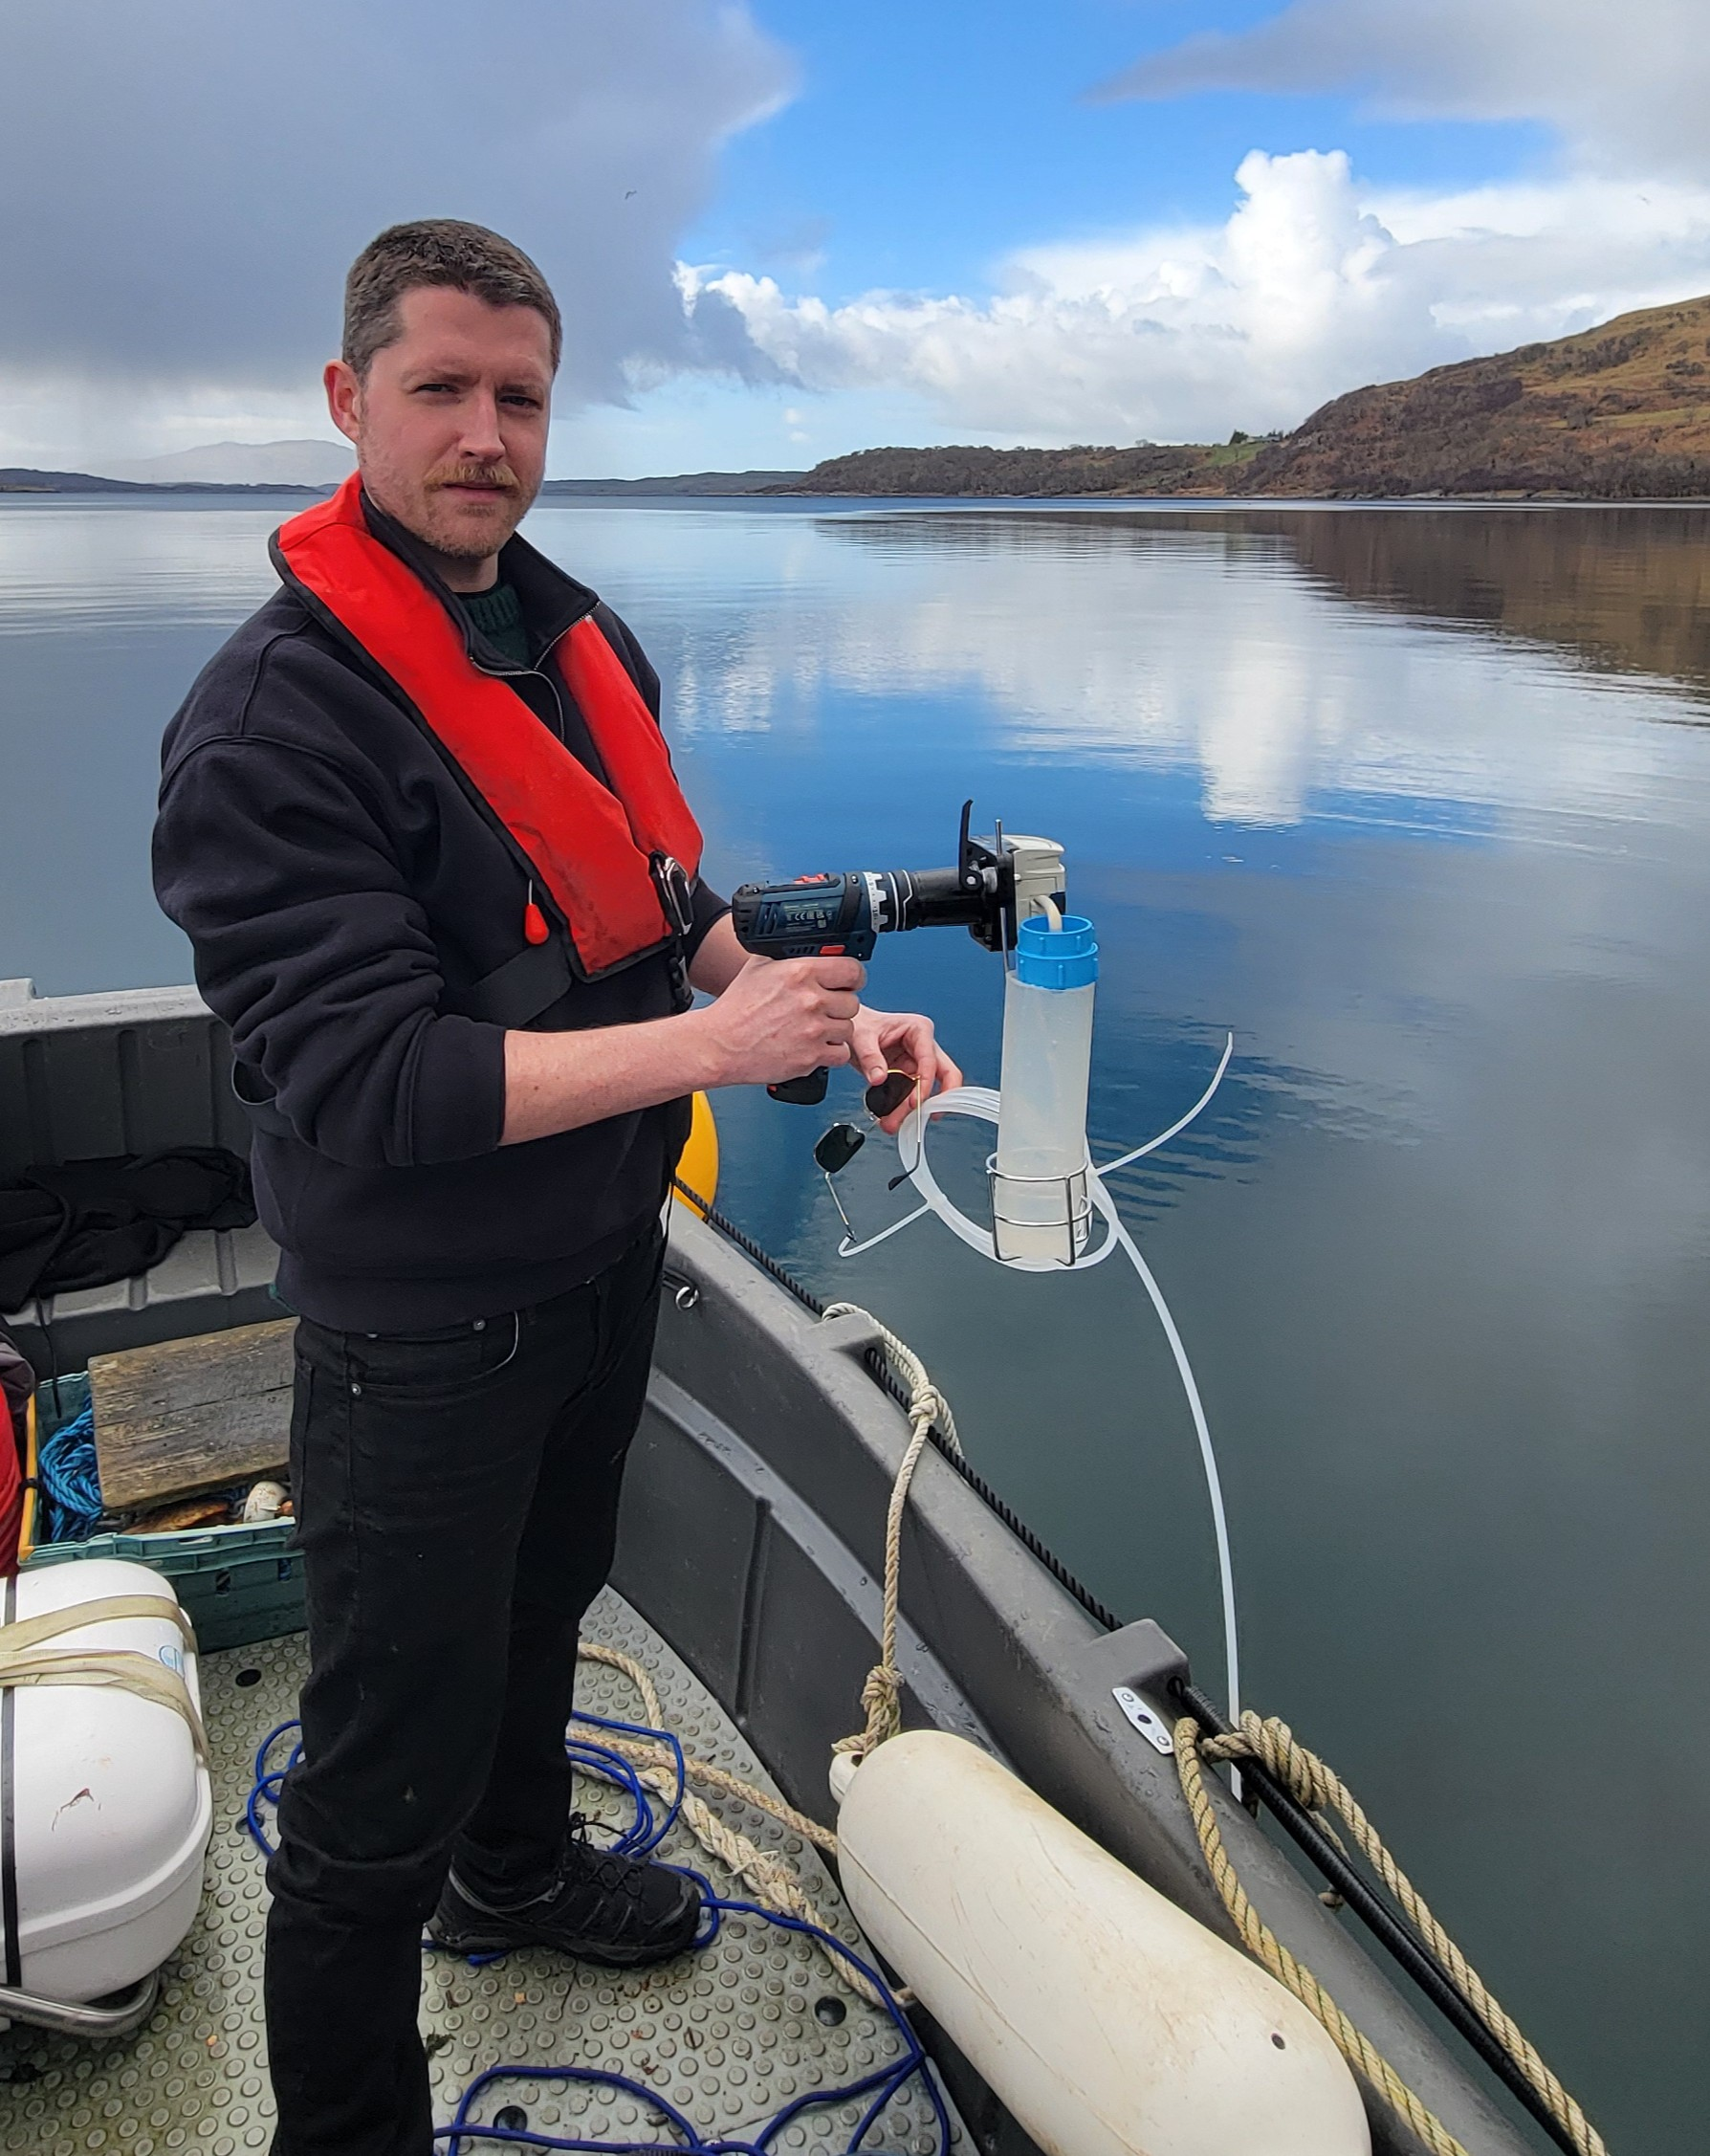
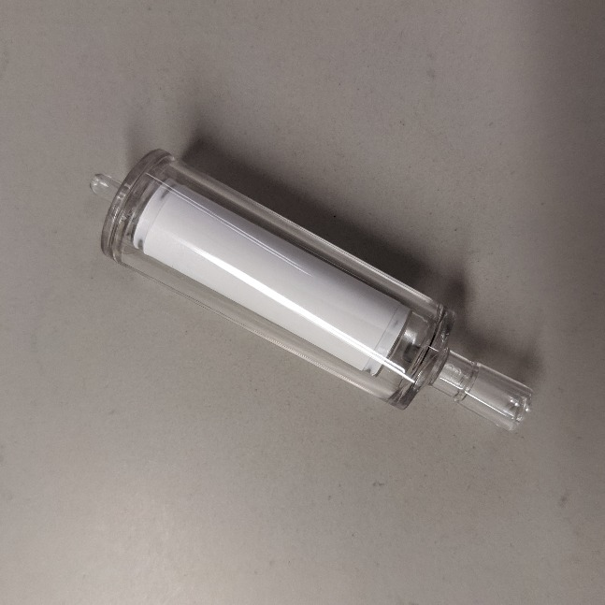
Sampling
Vampire sampler +
sterivex filter: plankton eDNA
Notes:
What does the sampling look like
To assess biofouling communities, we are collecting plankton samples and filtering seawater directly from the farms using a Vampyr sampler, which is basically a powerdrill with a peristaltic pump attached to a Sterivex filter from which eDNA samples is being extracted

Slide 21

Sampling
Vampire sampler +
sterivex filter: plankton eDNA
Smart sensor buoy: abiotic
Notes:
We are working in partnership with SOFTSEAWEED, a Norwegian company specializing in recently developed sensor buoys. These buoys will be deployed at each farm, and will continuously transmit abiotic data.
We are also going to measure current velocity and nutrient content and chlorophyll levels at all sites.

Slide 22
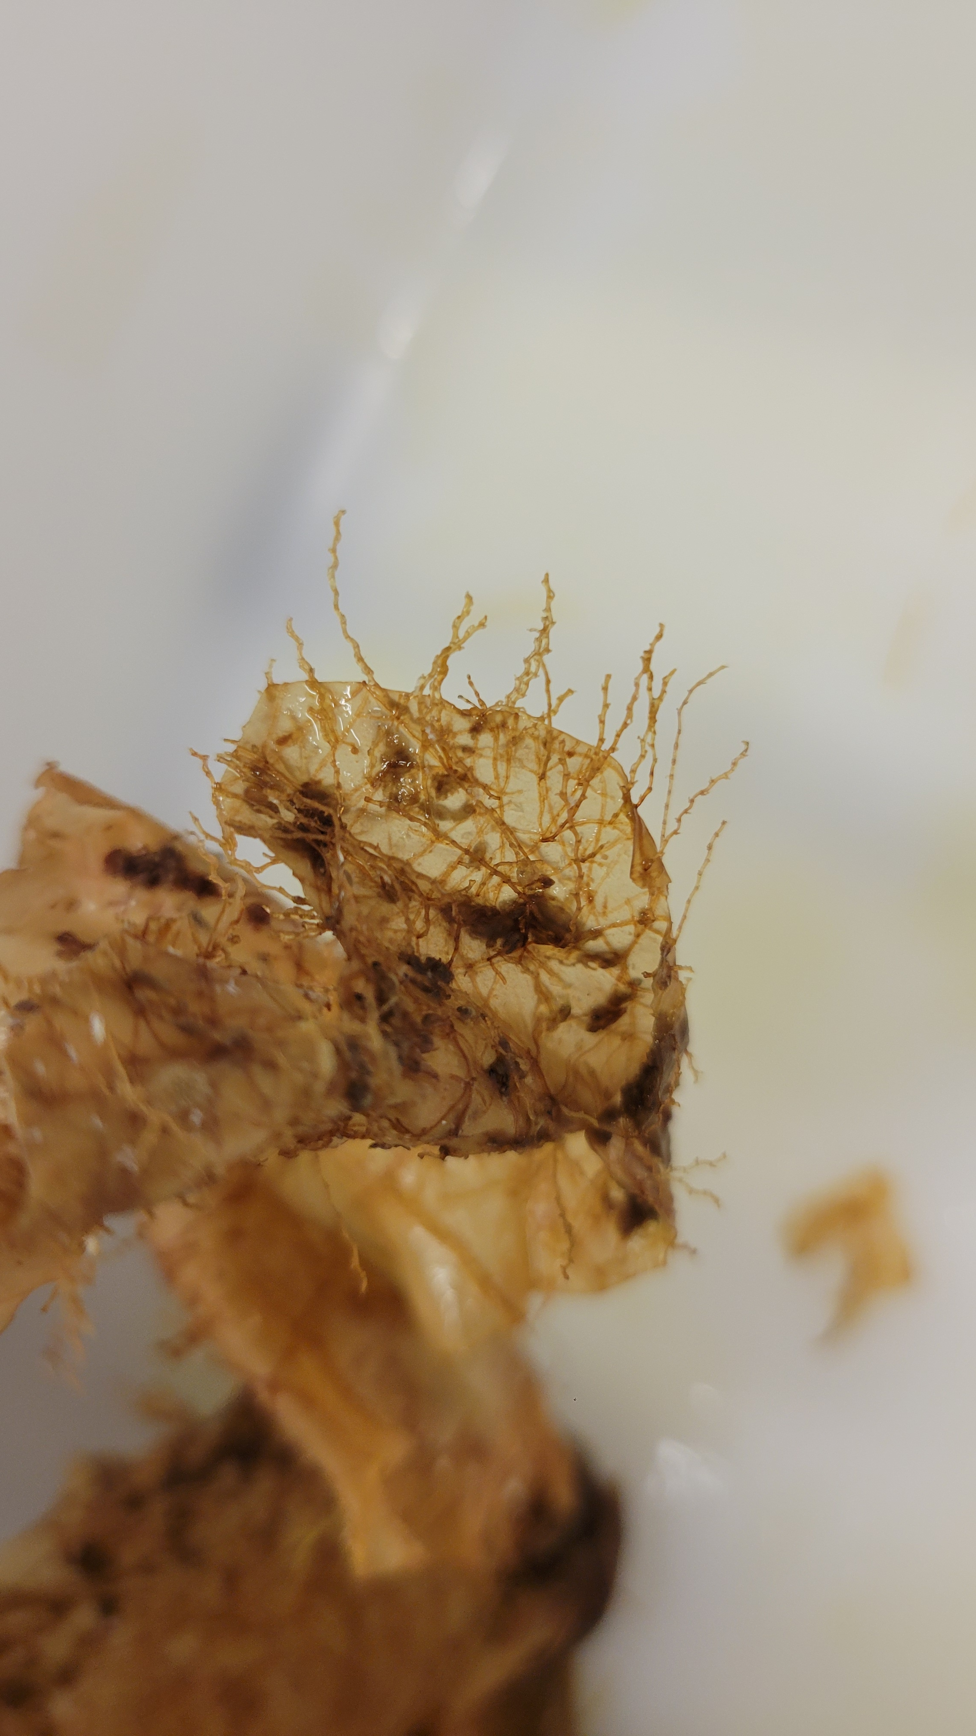
Sampling
Vampire sampler +
sterivex filter: plankton eDNA
Visual Surveys
+ zoo / phytoplankton
+ phytoplankton
+ Blade Epibionts
Smart sensor buoy: abiotic
Notes:
Microscopic visual surveys of plankton alongside visual identification of epibionts direct from the seaweed blades will be used to then validate the findings from the genetic material.

Slide 23
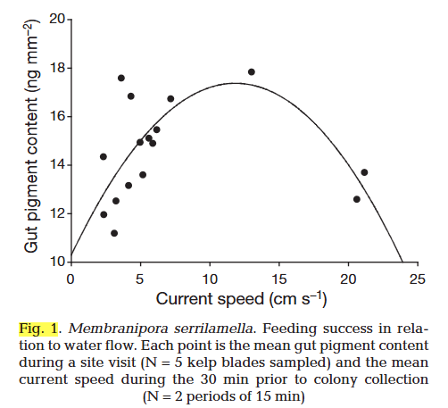
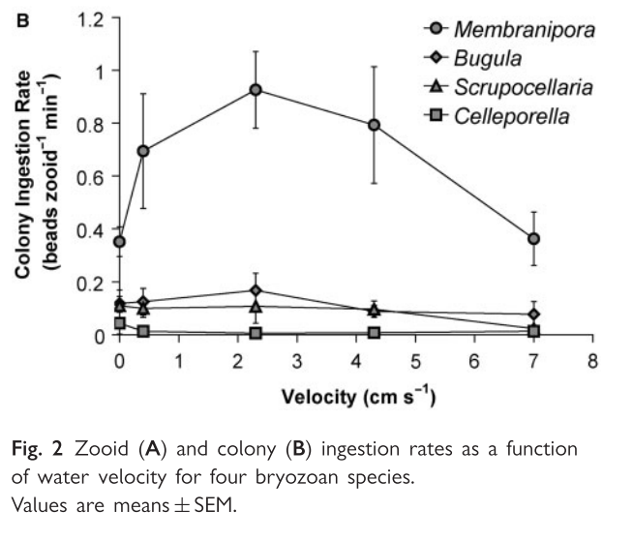
Feeding success was highest at intermediate ambient flow speeds and lowest at low and fast speeds (Arkema et al. 2009).
biofoulers have been shown to increase feeding activity and growth rates in gentle currents relative to stronger currents (Pratt, 2008, Visch et al., 2020).
Notes:
Additionally, during my literature review
I found that proliferation of bryozoans has been suggested to be mediated by current flow
If we infer feeding success to influence growth rate
absence of flowing seawater may limit feeding success and subsequent colony growth, (Arkema, 2009).
Colonies of encrusting biofoulers have been shown to increase both feeding activity and growth rates in more gentle currents relative to stronger currents (Pratt, 2008, Visch et al., 2020).
This somewhat goldilocks response to water current interested me and as flow velocity wasn’t originally part of the sampling design I had to come up with a solution – one which was cost effective

Slide 24
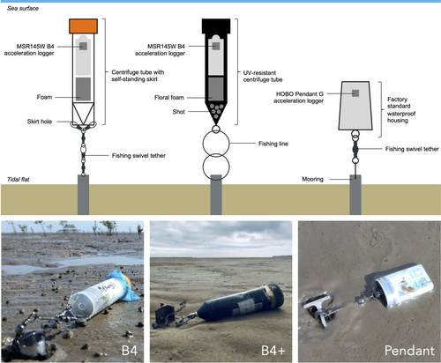
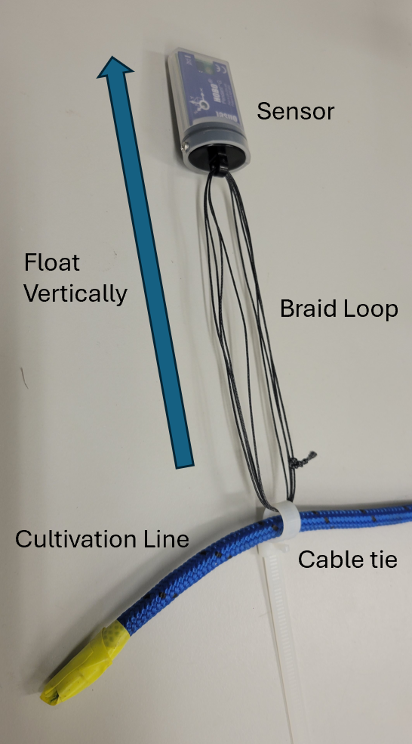
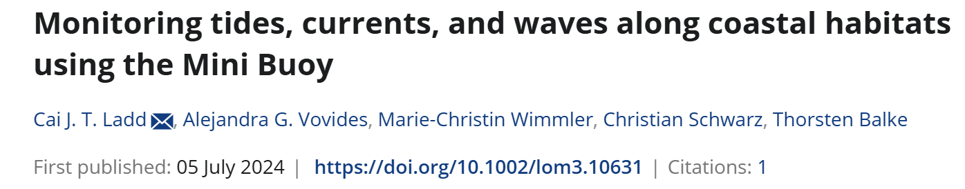
HOBO pendant accelerometer
Deployed at farms.
Notes:
So im going to measuring current velocity using hobo accelerometer –
In field – each farm has – converted to current velocity
Also have mescosm set up at millport where we can test this also
Not only seeing if the current influences colony growth but show is these loggers are effective for what we are trying

Slide 25
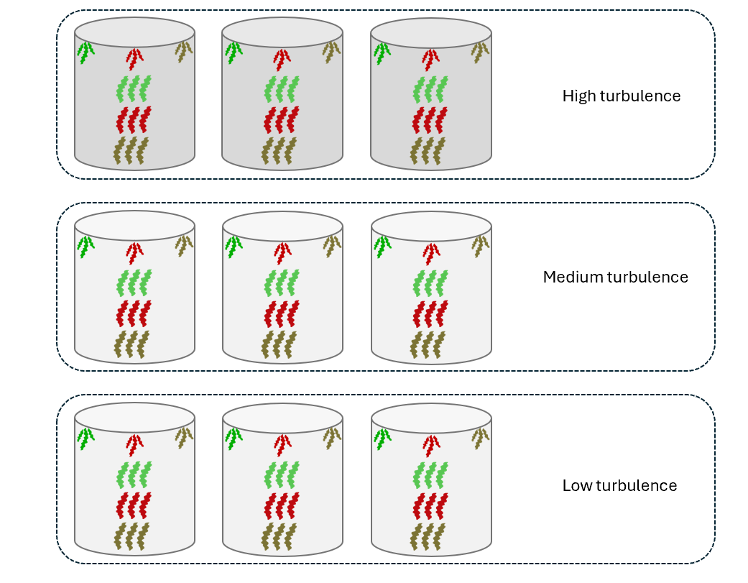
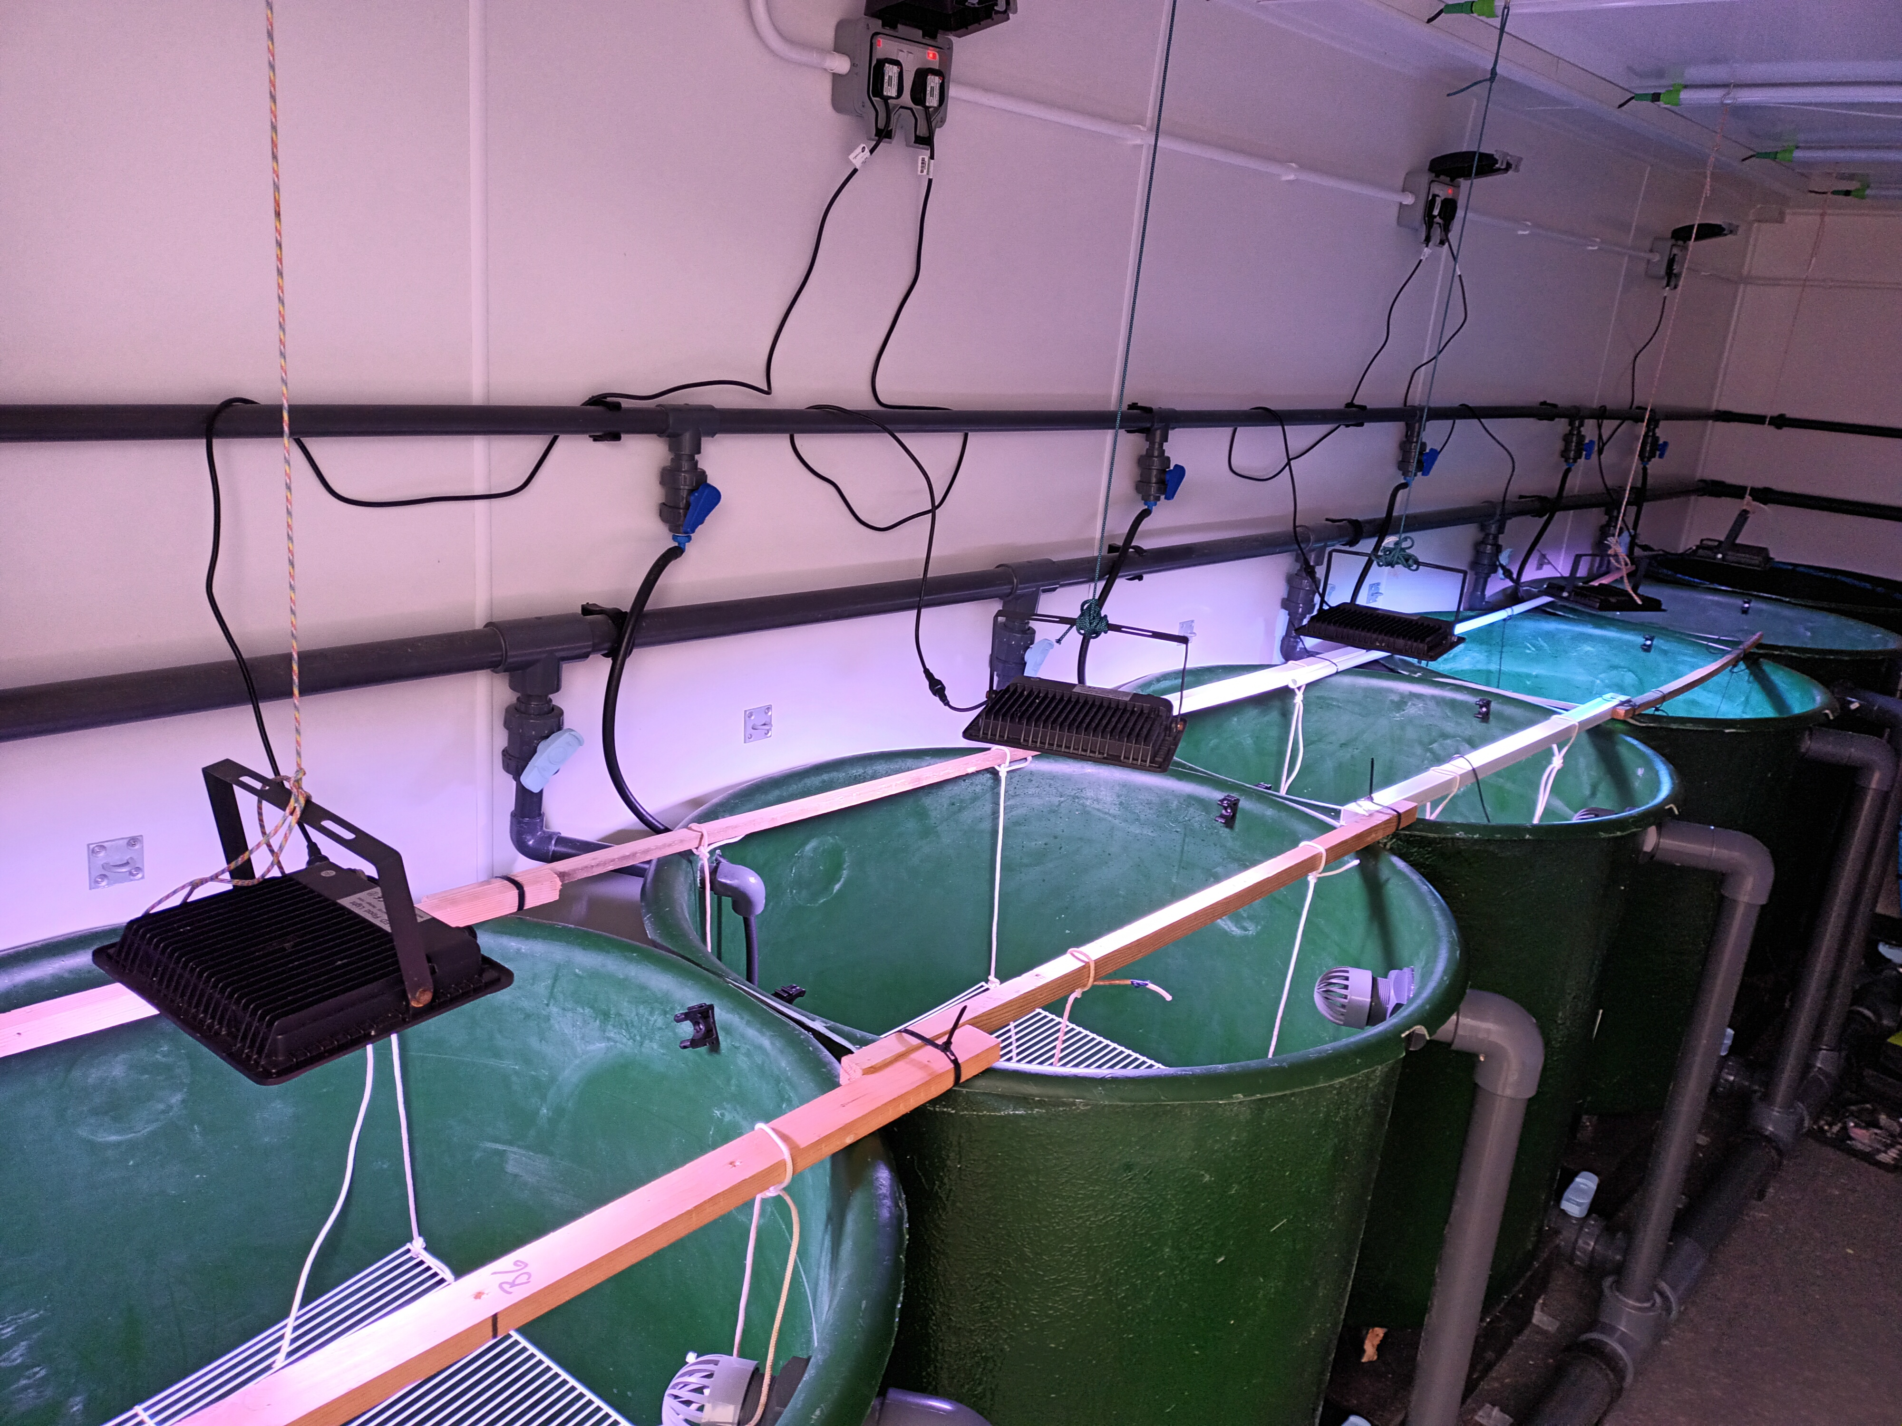
Mesocosm set-up at Millport
Notes:
So im going to measuring current velocity using hobo accelerometer –
In field
Also have mescosm set up at millport where we can test this also
Not only seeing if the current influences colony growth but show is these loggers are effective for what we are trying

Slide 26
Project Summary
Aim: Optimise eDNA as an early warning system for biofouling in seaweed aquaculture.
Approach:
Develop species-specific primers for key epibionts
Compare eDNA with microscopy to test predictive power
Link biofouling trends to environmental drivers (in situ snd in vitro)
Provide actionable tools for sustainable farm management

Slide 27
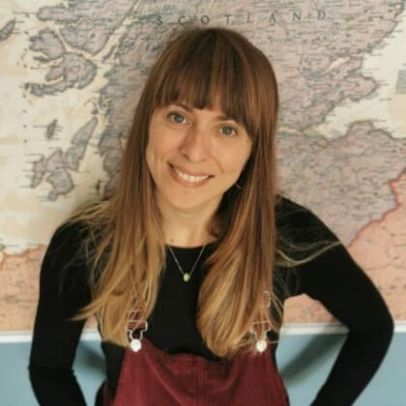
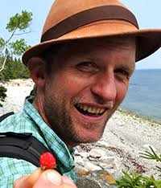
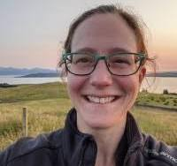
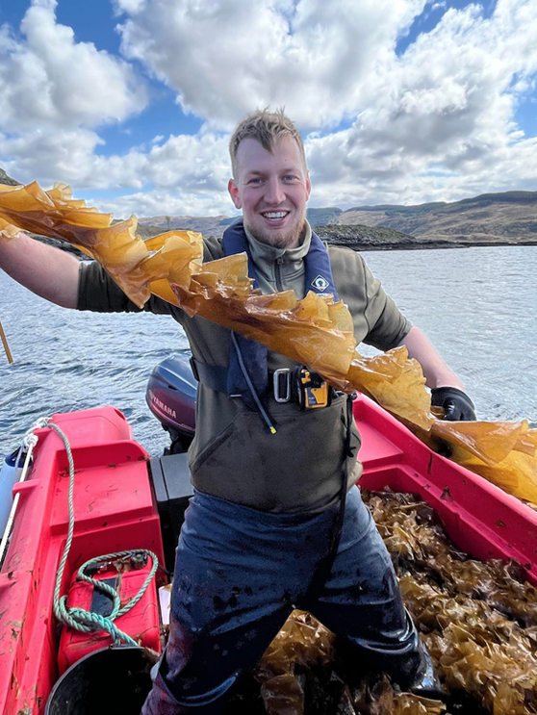


Special thanks to project supervisors and partners:
Dr Sofie Spatharis Prof Martin Llewellyn Dr Anna McGregor Marnik Van Cauter
UoG UoG UoG Kilchoan Melfort Trust
Brendan Robertson Claire Dagen Chris Proudlove Joshua Madely
BBSRC 2023 Sustainable Aquaculture Partnerships for Innovation
Notes:
My project is funded through partnership with Glasgow university, the Kilchoan Melfort trust and the UK government department of research and innovation as part of the Sustainable Aquaculture Partnerships for Innovation project
I have an excellent support team in my supervisors at Glasgow, Dr Sofie Spatharis, Professor Martin Llewellyn, and Dr Anna McGregor.
At the Kilchoan estate I am also working under the guidance of Marnik Van Cauter who is greatly talented and all things aquaculture and is maintaining one of our sampling farms.
Also massive thsnks to Brendan, claire and chris and josh for sll their help it is incredibly apprecisted
Also shout out to the orthopaedic dept at the queen elizabeth for putting me bsck togethet

Slide 28
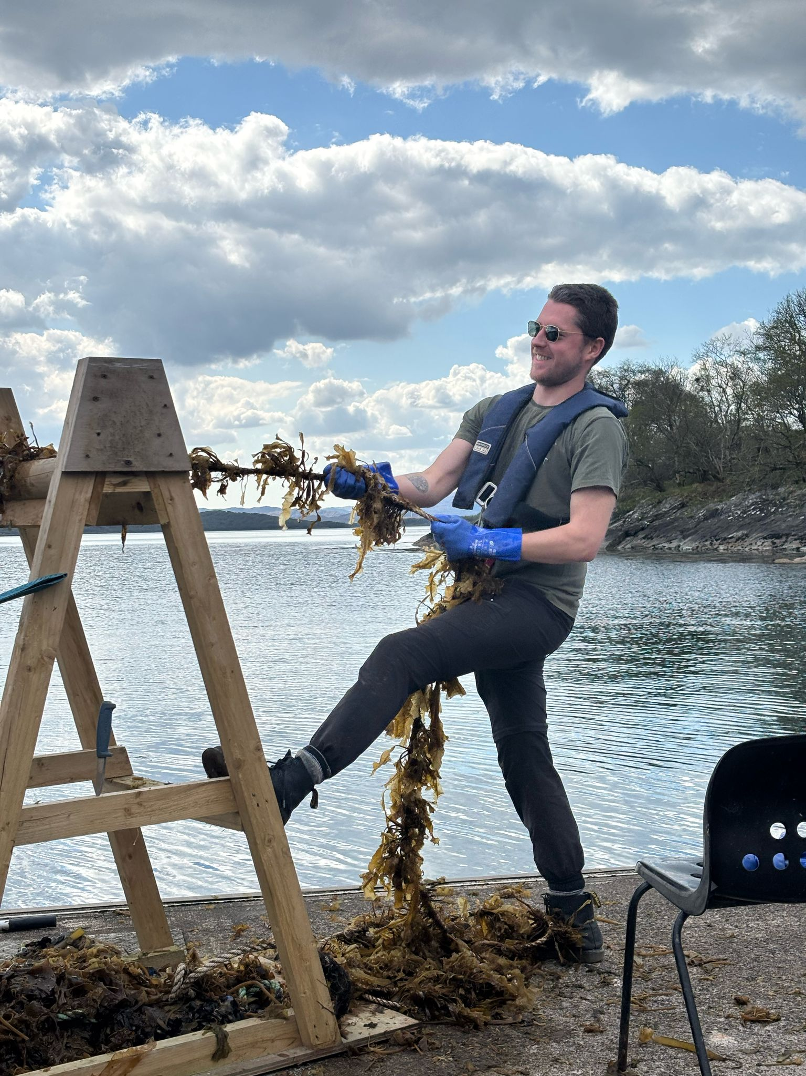
Thank you for listening
Calum Young
Calum.Young@glasgow.ac.uk

